Slide 1
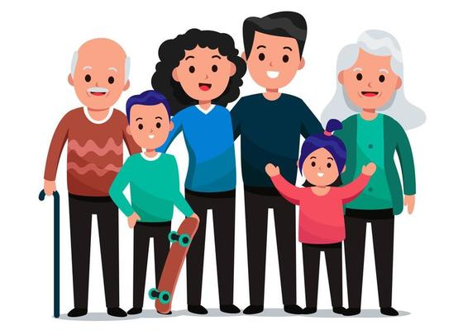
Family and Marriage
Ms. Kauser Malik
Lecturer (Psychology)
Sciences and Humanities

Slide 2
Learning Outcomes
Understanding the concept of family and marriage in sociology
Explanation of these concepts through different theories

Slide 3
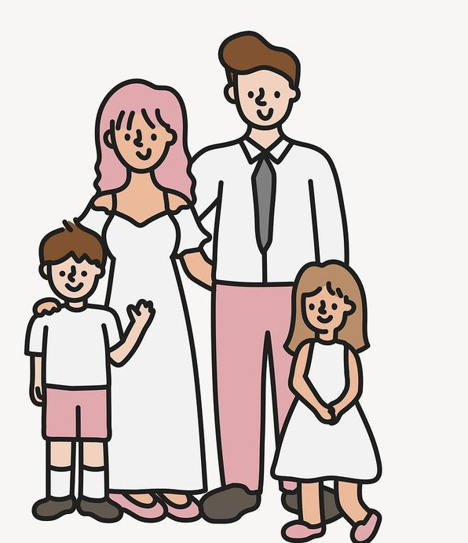
Family
A key social institution in all societies, which makes it a cultural universal. Of all the human groups, family is the most important one.
Two or more people who consider themselves related by blood, marriage, or adoption
Family is a socially recognized group that forms an emotional connection and serves as an economic unit of society.
Values and norms surrounding marriage are found all over the world in every culture, so marriage and family are both cultural universals. Statuses (i.e. wife, husband, partner, mom, dad, brother, sister, etc.) are created and sanctioned by societies.
Burgess and Locke defined family as “a group of persons united by ties of marriage, blood or adoption constituting a single household interacting and intercommunicating with each other in their respective roles of husband and wife, father and mother, so and daughter, brother and sister, creating a common culture”.

Slide 4
Types of Families
On the basis of structure
Nuclear Family: a family consisting of a husband, wife, and child(ren).
Extended Family: a family in which relatives, such as the “older generation "or unmarried aunts and uncles, live with the parents and their children.
Joint family: type of family in which two or more family live in one house.
Blended Family: A blended family, also known as a stepfamily, is a family formed when two people come together and bring a child or children from previous relationships. When a blended family is formed, the children might be of the same age group or have major age differences, and they might also have a child together.

Slide 5
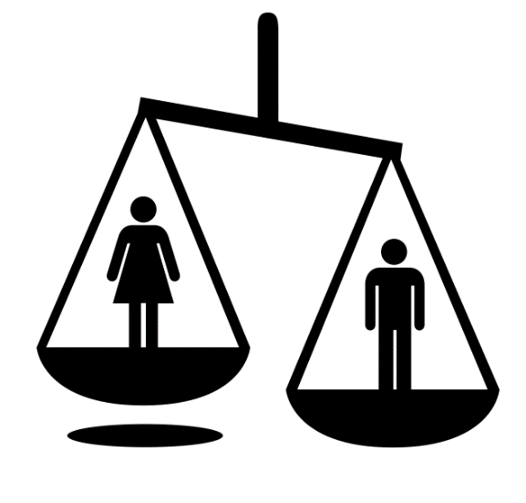
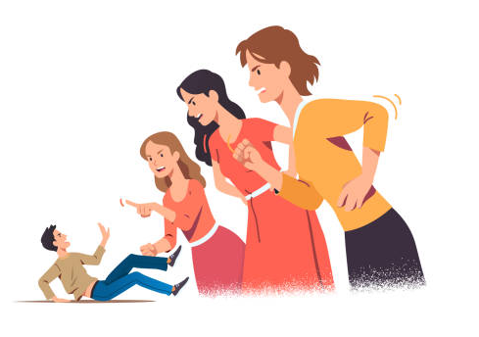
On the basis of Authority
Patriarchal - Male dominant, female subordinate
Matriarchal - Female dominant, males subordinate
On the basis of Marriage
Monogamous - One man marry one woman
Polygamous - One man marry two or more women
Polyandrous - One woman marry two or more men
Polygyny - a form of marriage in which men have more than one wife.

Slide 6

Household
Family of Orientation
Family of Procreation
the family formed when a couple’s first child is born
the family in which a person grows up
people who occupy the same housing unit

Slide 7
Theoretical Perspectives on Family
Sociologists study families on both the macro and micro level to determine how families function.
Symbolic Interactionism and Functionalism
While interactionism helps us understand the subjective experience of belonging to a “family,” functionalism illuminates the many purposes of families and their roles in the maintenance of a balanced society (Parsons and Bales, 1956).

Slide 8
Symbolic Interactionism and Functionalism
These two theories indicate that families are groups in which participants view themselves as family members and act accordingly. In other words, families are groups in which people come together to form a strong primary group connection and maintain emotional ties to one another. Such families may include groups of close friends or teammates.
In addition, the functionalist perspective views families as groups that perform vital roles for society—both internally (for the family itself) and externally (for society as a whole). Families provide for one another’s physical, emotional, and social well-being. Parents care for and socialize children. Later in life, adult children often care for elderly parents.

Slide 9
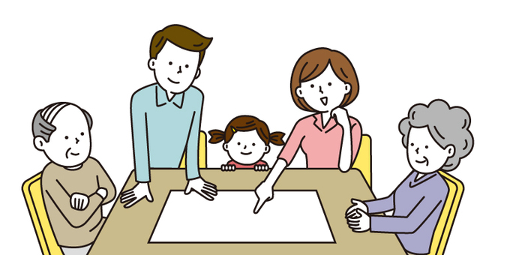
Functionalism - Role of family in society
Functionalists uphold the notion that families are an important social institution and that they play a key role in stabilizing society. Family members take on status roles in a marriage or family. The family—and its members—perform certain functions that facilitate the prosperity and development of society.
Sociologist George Murdock conducted a survey of 250 societies and determined that there are four universal residual functions of the family (Lee 1985):
sexual,
reproductive,
educational, and
economic
In each society, although the structure of the family varies, the family performs these four functions.

Slide 10
According to Murdock, the family (which includes the state of marriage) regulates sexual relations between individuals. The family offers a socially legitimate sexual outlet for adults (Lee 1985).
As the primary agent of socialization and enculturation, the family teaches young children the ways of thinking and behaving that follow social and cultural norms, values, beliefs, and attitudes.
Parents also teach children gender roles. Gender roles are an important part of the economic function of a family. division of labour - instrumental and expressive roles. According to functionalists, the differentiation of the roles on the basis of sex ensures that families are well balanced and coordinated. Each family member is seen as performing a specific role and function to maintain the functioning of the family as a whole.
When family members move outside of these roles, the family is thrown out of balance and must recalibrate in order to function properly.

Slide 11
Symbolic Interactionism
View the world in terms of symbols and the meanings assigned to them (LaRossa and Reitzes 1993). The family itself is a symbol. To some, it is a father, mother, and children; to others, it is any union that involves respect and compassion. Interactionists stress that family is not an objective, concrete reality.
“Parent” was a symbol of a biological and emotional connection to a child. With more parent-child relationships developing through adoption, remarriage, or change in guardianship, the word “parent” today is less likely to be associated with a biological connection than with whoever is socially recognized as having the responsibility for a child’s upbringing.

Slide 12
Interactionists also recognize how the family status roles of each member are socially constructed, playing an important part in how people perceive and interpret social behaviour.
Interactionists view the family as a group of role players or “actors” that come together to act out their parts in an effort to construct a family. These roles are up for interpretation. Symbolic interactionism therefore draws our attention to how the norms that define what a “normal” family is and how it should operate come into existence.
In the late 19th and early 20th century, a “good father,” for example, was one who worked hard to provided financial security for his children. Today, a “good father” is one who takes the time outside of work to promote his children’s emotional well-being, social skills, and intellectual growth.

Slide 13
Challenges families face
As the structure of family changes over time, so do the challenges families face. Events like divorce and remarriage present new difficulties for families and individuals. Other long-standing domestic issues such as abuse continue to strain the health and stability of families.
A great deal of marital problems can be related to stress, especially financial stress.
The addition of children to a marriage creates added financial and emotional stress.

Slide 14
Isolation and Emotional Overload
Functionalists also analyze dysfunctions.
The relative isolation of today’s nuclear family creates one of those dysfunctions. Because the members of extended families are embedded in a larger kinship network, they can count on many people for material and emotional support.
In nuclear families, in contrast, the stresses that come with crises—the loss of a job, a death, or even family quarrels—are spread among fewer people.
This places greater strain on each family member, creating emotional overload. In addition, the relative isolation of the nuclear family makes it vulnerable to a “dark side”—incest and other forms of abuse.

Slide 15
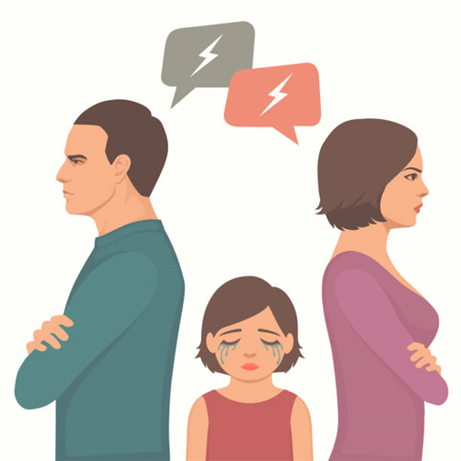
The Dark Side of family
Battering
Child Abuse
Domestic Violence
Marital Rape
Incest

Slide 16
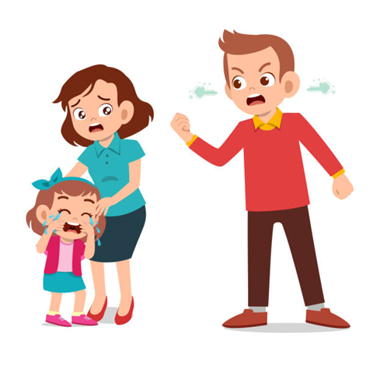
Violence and Abuse
Abuse can occur between spouses, between parent and child, as well as between other family members.
The frequency of violence among families is a difficult to determine because many cases of spousal abuse and child abuse go unreported.

Slide 17
Domestic Violence
Domestic violence is often characterized as violence between household or family members, specifically spouses.
To include unmarried, cohabitating, and same-sex couples, family sociologists have created the term intimate partner violence (IPV). Women are the primary victims of intimate partner violence. It is estimated that 1 in 4 women has experienced some form of IPV in her lifetime (compared to 1 in 7 men) (Catalano 2007).
IPV may include physical violence, such as punching, kicking, or other methods of inflicting physical pain; sexual violence, such as rape or other forced sexual acts; threats and intimidation that imply either physical or sexual abuse; and emotional abuse, such as harming another’s sense of self-worth through words or controlling another’s behaviour. (Centers for Disease Control 2012).

Slide 18
Household income and education levels appear to have little effect on experiencing spousal violence (Statistics Canada 2011).
Accurate statistics on IPV are difficult to determine, as less than one-quarter of victims report incidents to the police (Statistics Canada 2011). It is not until victims choose to report crimes that patterns of abuse are exposed.
IPV has significant long-term effects on individual victims and on society. Studies have shown that IPV damage extends beyond the direct physical or emotional wounds. Nearly all women who report serious domestic problems exhibit symptoms of major depression (Goodwin, Chandler, and Meisel 2003). Female victims of IPV are also more likely to abuse alcohol or drugs, suffer from eating disorders, and attempt suicide (Silverman et al. 2001).
Many people want to help IPV victims but are hesitant to intervene because they feel that it is a personal matter or they fear retaliation from the abuser—reasons similar to those of victims who do not report IPV.

Slide 19
Child Abuse and Corporal Punishment
Child abuse may come in several forms, the most common being neglect, followed by physical abuse, sexual abuse, psychological maltreatment, and medical neglect (Child Help 2011).
Infants younger than 1 year are the most vulnerable to family homicide, 98 percent of which were committed by parents (Sinha 2012). This age group is particularly vulnerable to neglect because they are entirely dependent on parents for care.
Some parents do not purposely neglect their children; factors such as cultural values, standard of care in a community, and poverty can lead to hazardous level of neglect.

Slide 20
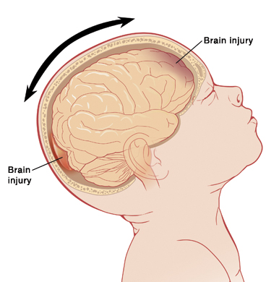
Infants are also often victims of physical abuse, particularly in the form of violent shaking. This type of physical abuse is referred to as shaken-baby syndrome, which describes a group of medical symptoms such as brain swelling and retinal hemorrhage resulting from forcefully shaking or causing impact to an infant’s head.
A baby’s cry is the number one trigger for shaking. Parents may find themselves unable to soothe a baby’s concerns and may take their frustration out on the child by shaking him or her violently.
Other stress factors such as a poor economy, unemployment, and general dissatisfaction with parental life may contribute to this type of abuse. (Sinha 2012).

Slide 21
Variations in Family Life
Single-parent households are also on the rise.
Stepparents are an additional family element in two-parent homes. A stepfamily is defined as “a couple family in which at least one child is the biological or adopted child of only one married spouse or common-law partner and whose birth or adoption preceded the current relationship” (Statistics Canada 2012).
In some family structures a parent is not present at all.
A grandparent functioning as the primary care provider often results from parental drug abuse, incarceration, or abandonment. Events like these can render the parent incapable of caring for his or her child.
Changes in the traditional family structure raise questions about how such societal shifts affect children.

Slide 22
Cohabitation
Cohabitation, when a man and woman live together in a sexual relationship without being married,
Living together before or in lieu of marriage is a growing option for many couples. Many couples view cohabitation as a “trial run” for marriage.
Most recent research has found that cohabitation has little effect on the success of a marriage. Those who do not cohabitate before marriage have slightly better rates of remaining married for more than 10 years (Jayson 2010).
Cohabitation may contribute to the increase in the number of men and women who delay marriage. The average age of first marriage has been steadily increasing. In 2008, the average age of first marriage was 29.6 for women and 31 for men, compared to 23 for women and 25 for men through most of the 1960s and 1970s (Milan 2013).

Slide 23

Marriage

Slide 24
Marriage
One of the universal social institution. Closely connected with the institution of family.
Marriage a group’s approved mating arrangements, usually marked by a ritual of some sort
A legally recognized social contract between two people, traditionally based on a sexual relationship and implying a permanence of the union. Established by the human society to control and regulate the sex life of human.
It’s a cultural universal, and like family, it takes many forms. Who gets married, what the marriage means to the couple and to the society, why people get married (i.e. economic, political, or for love), and how it occurs (i.e. wedding or other ceremony) vary widely within societies and between societies.
There is no definition which adequately covers all types of marriage.
“Contract for the production and maintenance of children”
“ Marriage is a relatively permanent bond between permissible mates”
“Marriage is the public joining together, under socially specified regulations of a man and woman as husband and wife”

Slide 25
Mate Selection
Each human group establishes norms to govern who marries whom.
Endogamy
Exogamy
the practice of marrying within one’s own group
the practice of marrying outside of one’s group

Slide 26
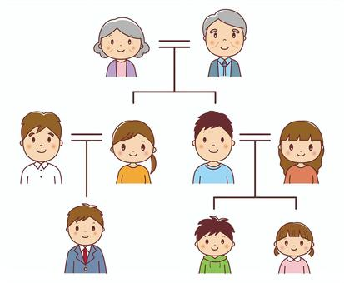
Inheritance
Marriage and family are also used to determine rights of inheritance.
No system is natural. Rather, each matches a group’s ideas of justice and logic.
Bilineal System
property is passed to both males and females
Patrilineal System
property is passed only to males
Matrilineal System (the rarest form)
property is passed only to females

Slide 27

Marriage and Family in Theoretical Perspective

Slide 28
The Functionalist Perspective: Functions and Dysfunctions
When functionalists look at marriage and family, they examine how they are related to other parts of society, especially the ways that marriage and family contribute to the well-being of society.
Functionalists stress that to survive, a society must fulfill basic functions (that is, meet its basic needs).

Slide 29
Why family is universal?
According to functionalists, the family fulfills five needs that are basic to the survival of every society. These needs, or functions are:
(1) economic production,
(2) socialization of children,
(3) care of the sick and aged,
(4) sexual control, and
(5) reproduction.
To make certain that these functions are performed, every human group has adopted some form of the family.

Slide 30
The Symbolic Interactionist Perspective: Gender, Housework, and Child Care
Throughout the generations, housework and child care have been regarded as “women’s work.”
As times changed and women put in more hours at paid work, men gradually did more housework and took more responsibility for the care of their children.
Shift of cultural ideas, with housework, care of children, and paid labor coming to be regarded as the responsibilities of both men and women.
Both husbands and wives are now putting in more hours taking care of family responsibilities.

Slide 31

The Conflict Perspective: Struggles between Husbands and Wives
Despite a couple’s best intentions—conflict is a part of marriage.
Conflict inevitably arises between two people who live intimately and who share most everything in life—from their goals and checkbooks to their bedroom and children.
Power is the source of much conflict in marriage. Who has it? And who resents not having it?
Throughout history, husbands have had more power, and wives have resented it.

Slide 32
More Child Care
Both husbands and wives are spending more time on child care. Today’s families are not strolling leisurely through life as huge paychecks flow in.
Today’s parents have squeezed out some of the extra time for their children by cutting down on their reading and the time they spend on preparing meals.
However, the main way that parents are getting the extra time is by spending about 5 hours a week less visiting with friends and relatives (Bianchi 2010).
This could be increasing the family’s “emotional overload.”

Slide 33
A Gender Division of Labor
Husbands still take the primary responsibility for earning the income and wives the primary responsibility for taking care of the house and children.
Major shift is taking place in this traditional gender orientation: Wives are spending more time earning the family income, while husbands are spending more time on housework and child care.
Anticipate greater marital equality in the future.

Slide 34
Divorce
Divorce is not only the end of marriage but a family as well.
In a patriarchal society, such as in Pakistan, the men dominate the women in multiple ways.
Our society perceives women as mannequins that must bear and adhere to societal constraints. This leads to domestic abuse, in the form of verbal, physical and mental torture. Thus, forcing the woman to seek separation or divorce from her husband.
One of the leading reasons for the higher divorce rate in Pakistan is the longstanding domestic abuse and forced marriages

Slide 36

The Bright Side of Family Life: Successful Marriages
Successful Marriages Sociologists Jeanette and Robert Lauer (1992) interviewed 351 couples who had been married fifteen years or longer. Fifty-one of these marriages were unhappy. The couples had stayed together for religious reasons, because of family tradition, or “for the sake of the children.”
Happy couples :
1. Consider their spouse to be their best friend, like their spouse as a person
2. Think of marriage as a long-term commitment. Believe that marriage is sacred
3. Agree on aims and goals
4. Believe that their spouse has grown more interesting over the years
5. Strongly want the relationship to succeed. Laugh together

Slide 37

The Bright Side of Family Life: Successful Marriages
Sociologist Nicholas Stinnett (1992) studied 660 families from the United States and South America. He found that the happy families:
1. Spend a lot of time together
2. Are quick to express appreciation
3. Promote one another’s welfare
4. Do a lot of talking and listen to one another
5. Are religious
6. Deal with crises in a positive manner

Slide 38
The Future of Marriage and Family
It is universal so it will not collapse as an institute.
More decision making power will be owned by females in coming times.

